Slide 1

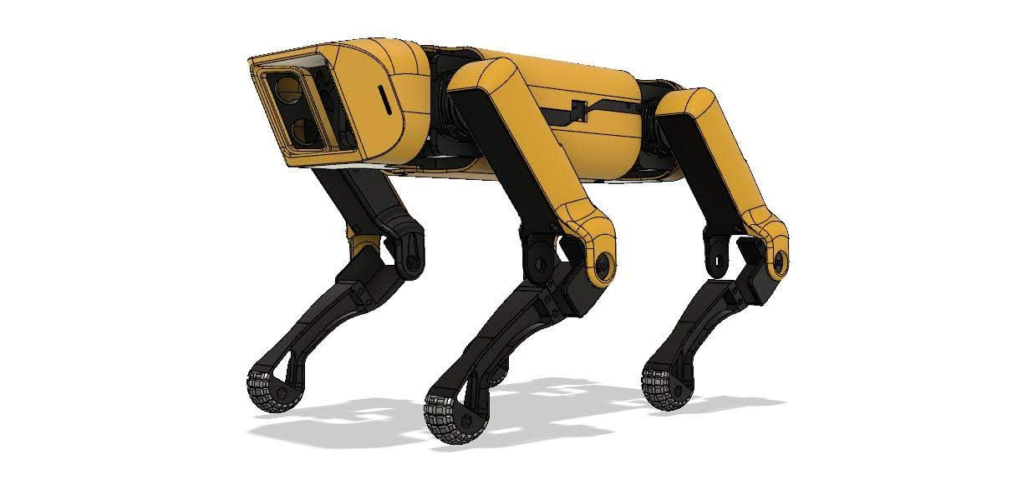
3DOF QUADRUPED
Inspired by Boston Dynamics’ Spot Mini
Project Superviser:
Dr. Deep Seth
Mahindra University
Department of Mechanical
And
Aerospace Engineering
Team members:
Sikhi Chintalapati (SE25MROB007) Yasho Ravali P. (SE25MROB006)
Galla Rishi (SE25MROB005)

Slide 2
Introduction and Background
Background of SpotMicroAI
SpotMicroAI is an open-source quadruped robot inspired by Boston Dynamics SpotMini.
It is developed as a low-cost platform for robotics research and education.
The robot uses 3DOF legs, servo motors, Raspberry Pi, and ROS integration.
It supports gait generation, walking, trotting, and inverse kinematics experiments.

Slide 3
Literature Survey
Robot / Research | Features | Limitation
Boston Dynamics Spot | Dynamic locomotion, obstacle climbing, autonomous navigation | Very expensive
Unitree Robotics Go1 | AI-based locomotion and vision system | Costly for research labs
MIT Mini Cheetah | High-speed running and backflips | Complex actuator design
ANYbotics ANYmal | Industrial inspection and terrain adaptability | High computational complexity
Stanford Doggo | Low-cost educational quadruped robot | Limited stability at high speed
ROS-based Quadruped Research | Modular simulation and easy integration | Requires high processing power
Reinforcement Learning-based Quadrupeds | Adaptive gait generation | Large training data required
Hydraulic Quadruped Robots | High load carrying capability | Heavy and expensive
SpotMicroAI | Open-source, low-cost quadruped platform | Limited payload capacity

Slide 4
Technological Gap and Problem Statement
Technological Gap:
High cost quadruped systems
Limited sensing integration in student projects
Difficulty in gait synchronization
Lack of autonomous obstacle awareness
Problem Statement:
Develop a low-cost quadruped robot capable of trot gait locomotion and LiDAR-based obstacle detection using ROS2.

Slide 5

Objective
Develop quadruped robot platform
Implement trot gait locomotion
Interface servo motors using PCA9685
Develop ROS2-based gait control- Integrate RPLiDAR A2
Implement autonomous WALK/STOP behavior

Slide 6
Mechanical Design and CAD
Include:-
CAD images
3D printed parts
Leg assembly images

Slide 7
Hardware Architecture
Explain:
Raspberry Pi 4
Servo Motors
Bluetooth Controller
Battery
3D Printed Legs

Slide 8
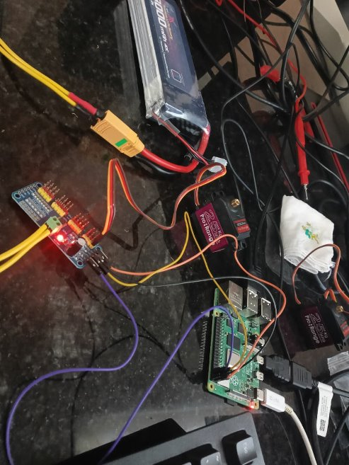
Experimentation: Servo Testing
Servo calibration images
PCA9685 setup
Wiring setup
Bullet points:-
Neutral angle calibration
PWM channel mapping
Joint synchronization
Power testing

Slide 9
Software Architecture
Flowchart:
/scan
↓
lidar_decision.py
↓
/gait_mode
↓
lidar_walk.py
↓
/joint_states
↓
all_leg_servo_driver.py
↓
Servo motors
Bullet points:-
ROS2 Humble framework
Python-based nodes
Real-time topic communication
Joint-space gait control

Slide 10
Experimentation: LiDAR Testing
LiDAR images
ROS2 terminal screenshots-
/scan topic output
Bullet points:-
RPLiDAR A2 integration
Real-time scan acquisition
Obstacle detection testing
WALK/STOP validation

Slide 11
Experimental Results

Slide 12
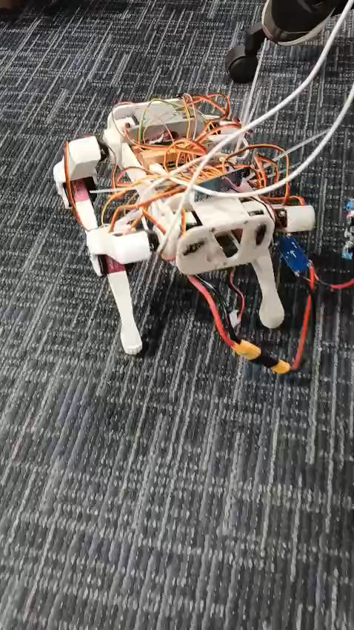

Slide 13
Results Locomotion
Locomotion Results:
Stable trot gait achieved
Walking motion demonstrated
Servo synchronization verified
LiDAR Integration Results:
Real-time LiDAR scan acquisition
Obstacle detection achieved
Autonomous WALK/STOP behavior verified

Slide 14
Challenges Faced
Mention:
Balance issues (Due to 3D prints)
Synchronization
Mechanical instability
Power fluctuations

